Slide 1
US National Parks Data Engineering Project
July
2024
Where would you like to go next?

Slide 2
Meet the Team

Slide 3



Melissa Morales
Victoria Scott
Stephanie Souza

Slide 4
NPS Project Plan
Considerations:
Amenities
Activities
Location
Temperature
Cost
Evaluate and describe key aspects about the various US National Parks to assist in decision making for individuals and families planning their visits.

Slide 5
Project Process
Data Engineering Track
ETL Workflow
Extract
Transform
Load
Performed various API pulls from the National Park Service and Open-Meteo Weather websites to obtain source data and produce csv and json output files.
Code prepared in Visual Studio Code Program and/or Jupyter Notebooks, using Python language.
Libraries used included json, requests, pprint, pandas, config, api_keys, os, and shutil.
Cleaned, organized and modified extracted data files to prepare cohesive, well-organized datasets to be used for data analysis.
Code prepared in Visual Studio Code Program, using Python language.
Only pandas library was used.
Decided to use csv over json during merges due to user comfort.
The final cleaned datasets contained very different information, therefore MongoDB was chosen for its flexibility.
Two collections were loaded into the National Parks database:
Activities and Amenities
Entrance Fees
Libraries used included pymongo and csv.

Slide 6
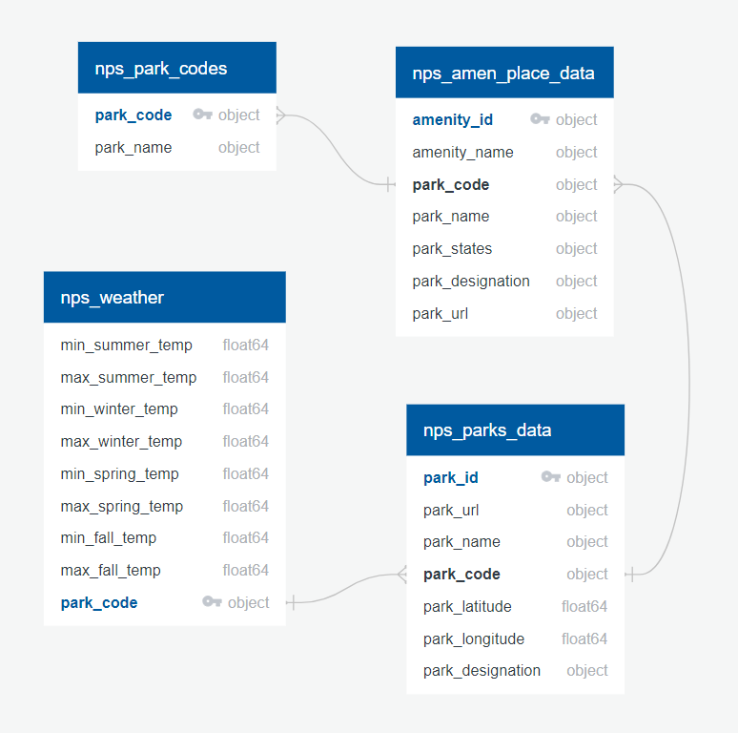
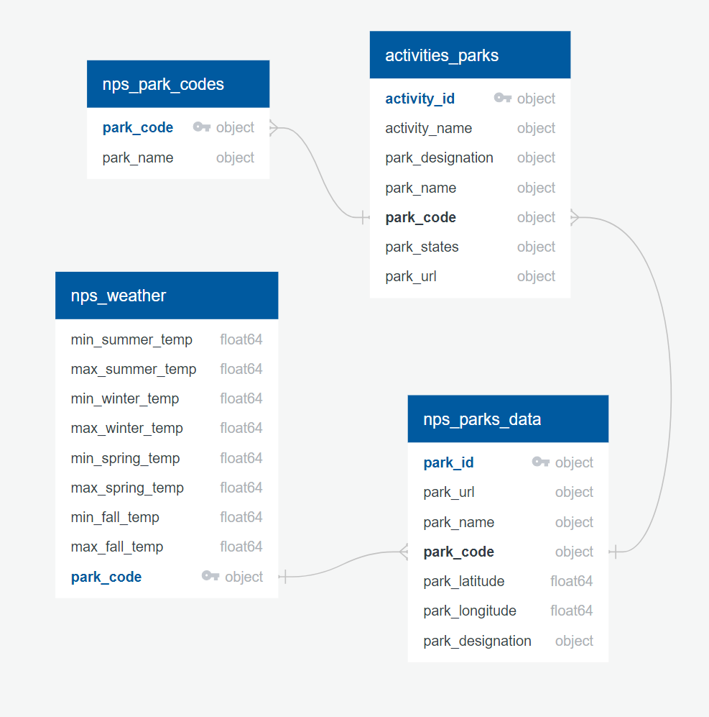
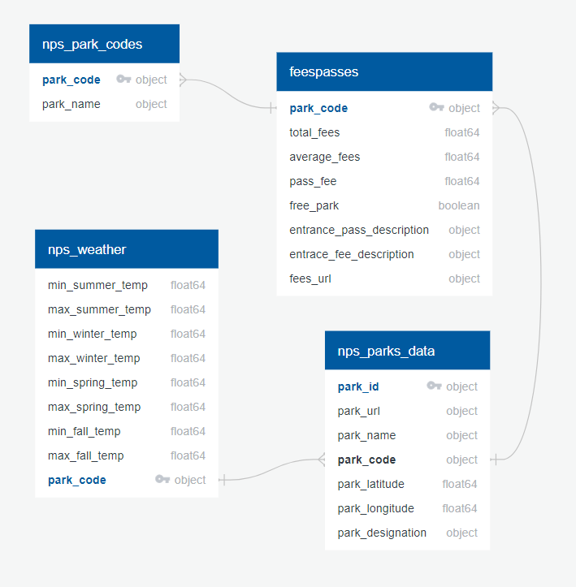
ERD Diagram
For Information Only – NoSQL Database Used

Slide 7
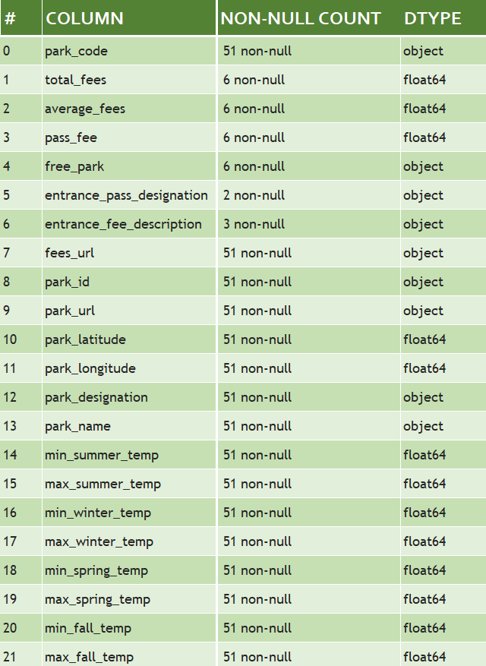
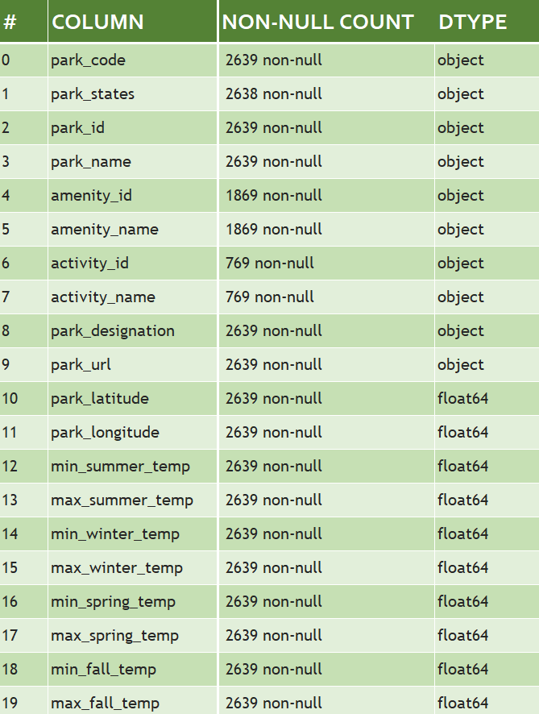
The Data
Entrance Fees
4 datasets pulled from the National Parks service API.
2 datasets pulled from the Open-Meteo Weather API.
Performed a series of merges based on common column = park_code
Final datasets for import into MongoDB:
Amenities and Activities By Place

Slide 8
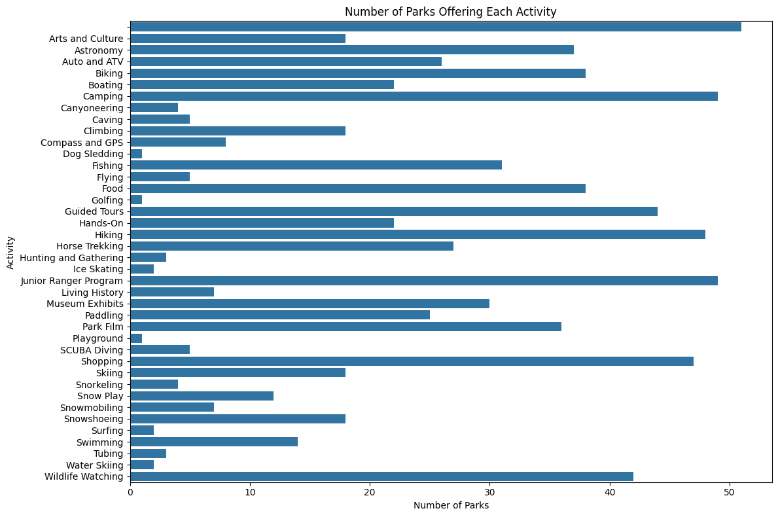
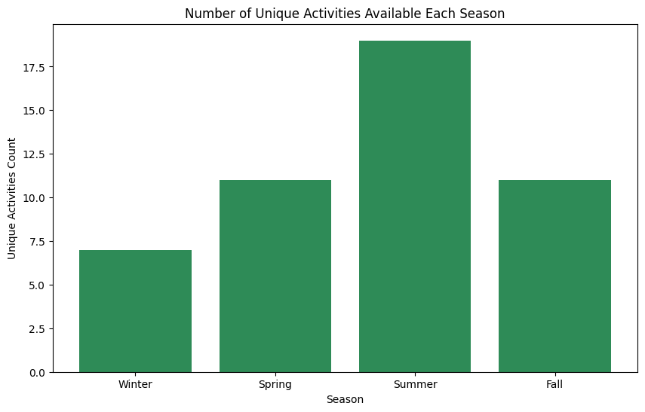
Data Analysis Using MatPlotLib
The data included in the Activities and Amenities collection, within the National Parks database, was transformed into basic visualizations, such as bargraphs, to evaluate the available data.

Slide 9
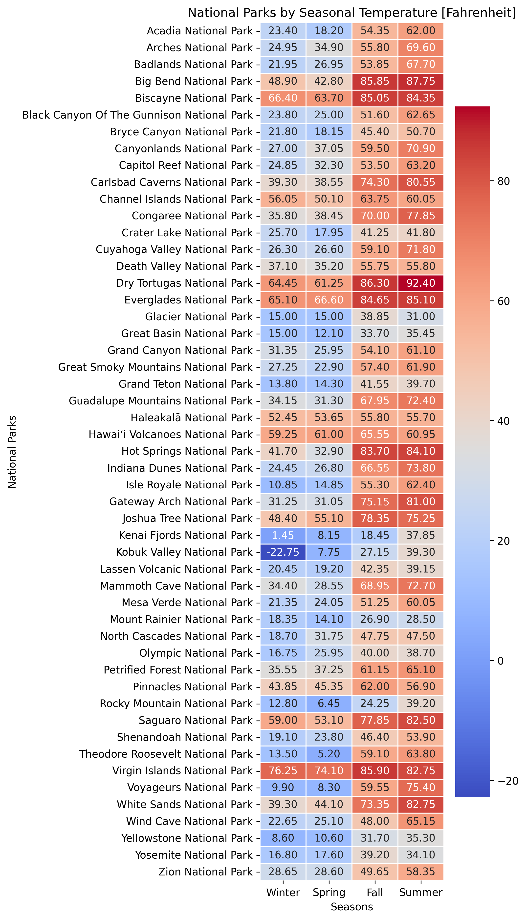
Find Perfect Weather for Your Next Adventure
Visitor Planning: Identifies ideal visit times based on temperature preferences
Conservation Insight: Helps understand climate impacts on park ecosystems
Comprehensive Tool: Provides an overview for better visit decisions and climate trends.

Slide 10
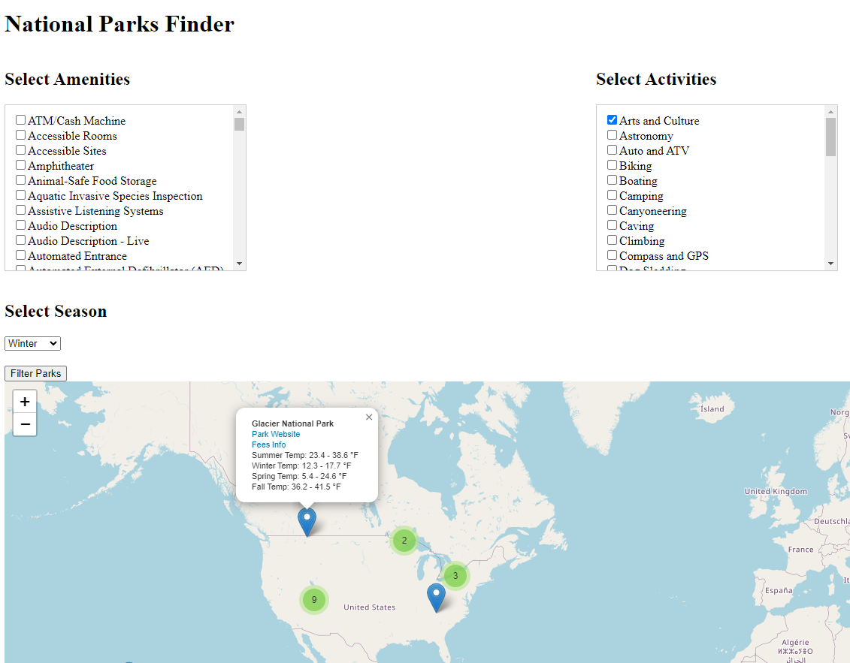
Website
National Parks Finder
Our National Parks Finder app is a web-based application designed to help users discover national parks based on their desired amenities and activities. Built with a Flask backend and a MongoDB database, the app provides an interactive map that displays parks matching the user's preferences. Users can filter parks by selecting from a variety of amenities and activities, and choose the season they are interested in. The app dynamically updates the map to show relevant parks, providing detailed information about each one. This tool is perfect for planning trips and exploring the best that national parks have to offer.

Slide 11
THANK YOU!
Questions?
Visit our Repo
https://github.com/melmelmorales/ETL_Project

